Slide 1

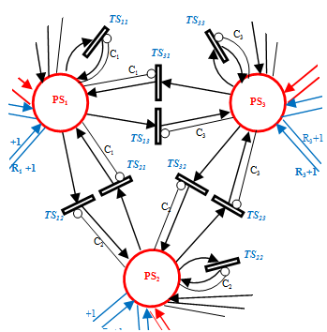
Project 13 - Autonomous Systems
Petri-Net-based or FSA-based Coordination of a 2-robot Task

Slide 2
What are Petri-nets?
Petri-net is a way to describe a distributed systems.
Nodes (transitions, bars)
Places (conditions, circles)
Arcs
Tokens
Stochastic Petri nets - transitions fire after a probabilistic delay determined by a random variable.

Slide 3
Alignment
Design a Petri net with the steps of the executed task by each robot and all synchronization steps.
Compare the system’s performance vs the predicted performance using Stochastic Petri Net or Stochastic Automata task modeling.

Slide 4
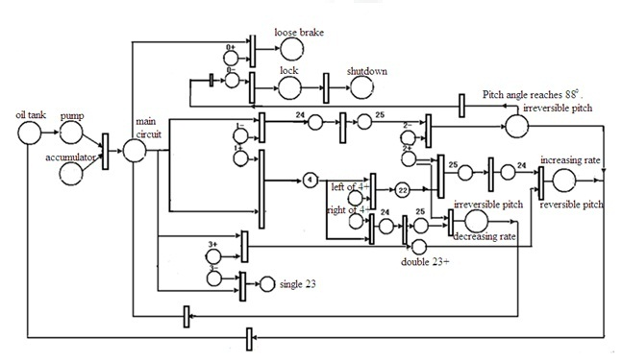
ROS - Petri-net plans package

Slide 5
Goals
Two real robots will cooperate to execute a task (to be defined by the group, e.g.,
transportation of large object, or distributed execution of subtasks concurrently when they can
be parallelized).

Slide 6
Hardware

Slide 7

Questions

Slide 8
References
http://www.dis.uniroma1.it/leonetti/index.php?option=com_content&task=view&id=56&Itemid=54
https://sites.google.com/a/dis.uniroma1.it/petri-net-plans/
http://www.dis.uniroma1.it/~iocchi/publications/iocchi-jaamas11-draft.pdf

Slide 9
Informações que podemos colocar1q
It is easy to show that PNPs are strictly more expressive than Finite State Machines (FSM). Moreover, PNPs allow for automatic plan analysis, which can provide formal guarantees on the performance of the plans. Execution of PNPs is extremely efficient and allows the design of real-time pro-active and reactive behaviors.
The expressive power of Petri Nets allows us to compactly represent conditional plans with loops, parallel action execution, interrupts, and partial observability.
Writing the plan is the first thing to do because doing so you will define actions and conditions required during execution.

Slide 10
cenas
6.2 Multi-Robot Interrupt
A common problem, in multi-robot systems, is the ability to react quickly to changes in the environment. For example, consider again
the problem of two soccer robots, one which was assigned the task to pass the ball, and one which was assigned the task to receive it.
Both robots are committed to the coordinated task, and thus one robot will wait for a pass until the other robot will perform the pass.
What if an opponent robot steals the ball, and the passer fails his task? If the passer robot perceives the event, he should abort the
passing behavior and move on to some recovery strategy.

Slide 11
cenas
Notice that these structures do not yet have all the features needed for execution. Therefore in the following section we will define additional properties that must be respected in order to fully characterize PNPs.
Definition 1
The PNP strucure described by PNPL is defined as:
– an ordinary or a sensing action
– the sequence of two PNPs
– the loop-sequence of a PNP
– the interrupt of a PNP with another PNP
– the loop-interrupt of a PNP
– the sequence of fork operator with two PNPs
– the sequence of join operator with two PNPs

